Slide 1
SOLID
JAVA WEEK 2

Slide 2

CONTENTS PAGE
What is SOLID?
Why use SOLID
A wider look at design principles
SOLID Principles in detail

Slide 3
Course objectives
Describe each of the components of the SOLID design principle.
Discuss why the SOLID principles should be adopted in OOP

Slide 4
What is SOLID?
SOLID is a mnemonic acronym for five design principles:
Single Responsibility Principle
Open-Closed Principle
Liskov Substitution Principle
Interface Segregation Principle
Dependency Inversion Principle
Notes:
Don’t talk about the principles here, as they will be discussed in more detail later

Slide 5
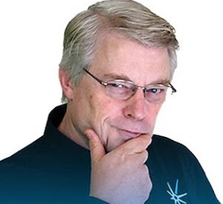
Why use SOLID?
The SOLID principles are intended to improve the comprehensibility, flexibility and maintainability of the software.
Due to the flexibility it offers, it integrates well within agile methodologies.
The SOLID principles were published by Robert C. Martin in 2000. He is best known as one of the authors of the Agile Manifesto.

Slide 6
A wider look at design principles
There are other design principles than SOLID. Other examples include:
GRASP - General Responsibility Assignment Software Principles.
DRY – Don’t Repeat Yourself.
KISS – Keep It Simple Stupid
All of these design principles and patterns try to solve the same thing. They try to resolve some of the common problems which are encountered during a software development project!

Slide 7

S - Single Responsibility Principle
The single responsibility principle is that each class should have a single responsibility!
If a class has multiple responsibilities, it should be broken down into smaller components.

Slide 8

S - Single Responsibility Principle
Example Problem:
Think of a “God” class. A class that does too much or knows too much.
This class is likely to change with every requirement change.
One code change on area we want to change, will likely affect other parts of that class, which we don’t want changed
This will cause changes to how other classes interact with it.
The final result will be a big mess of code – which would be inherently unmaintainable.

Slide 9
S - Single Responsibility Principle
Solution:
Break the “God” class into smaller classes.
Each with a single responsibility.
If there is a single change to be made, then there will be a single class to alter.
A major change to a class, should not affect any other classes.

Slide 10
O – Open/Closed Principle
The open closed principle states that classes should be open for extension, but closed for modification.
From a high level, this makes sense – you want developers to extend and add to your functionality, without having to directly change it.
Essentially, we should strive to write code that doesn’t have to be changed every time the requirements change.

Slide 11
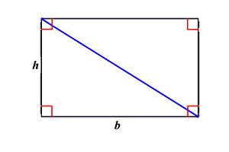
O – Open/Closed Principle
Example problem:
Lets say we want to build a function which gives me the area of a shape.
public int getArea(Shape shape) {
if (shape instanceof Rectangle) {
return shape.height * shape.width;
}
else if ( shape instanceof Traingle) {
return shape.height * shape.width / 2;
}

Slide 12
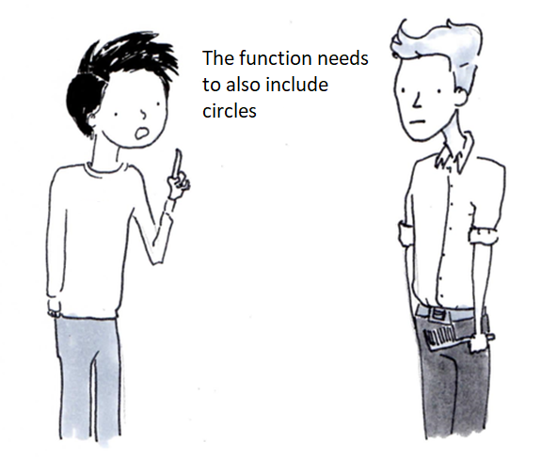
O – OPEN/CLOSED PRINCIPLE
client
Therefore we edit the source code

Slide 13

O – Open/Closed Principle
Example problem:
public int getArea(Shape shape) {
if (shape instanceof Rectangle) {
return shape.height * shape.width;
} else if ( shape instanceof Traingle) {
return shape.height * shape.width / 2;
} else if ( shape instanceof Circle) {
return (int) (shape.height/2 * shape.height/2 * Math.PI);
}
return 0;
}

Slide 14
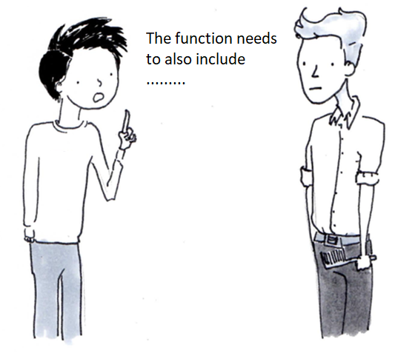
O – OPEN/CLOSED PRINCIPLE
client
Therefore we edit the source code again, and again.

Slide 15
O – Open/Closed Principle
Example problem:
The longer this goes on the messier our code becomes.
public int getArea(Shape shape) {
if (shape instanceof Rectangle) {
return shape.height * shape.width;
} else if (shape instanceof Traingle) {
return shape.height * shape.width / 2;
} else if (shape instanceof Circle) {
return (int) (shape.height/2 * shape.height/2 * Math.PI);
} else if ...
}

Slide 16
O – Open/Closed Principle
Solution:
Rather than changing the functionality of the function, create a shape abstract class.
To this shape class add an abstract method ‘calculateArea()’
Rectangle, triangle and circle should then inherit from this shape class.
Each class overrides the calculateArea() method.
Abstract Shape
- calculateArea()
Rectangle
- calculateArea() {}
Triangle
- calculateArea(){}

Slide 17
O – Open/Closed Principle
Solution:
The abstract method is open for extension. We can easily create a trapezium class which inherits from shape, and configure it to the trapezium
public int getArea(Shape shape) {
return shape.calculateArea();
}
Abstract Shape
- calculateArea()
Rectangle
- calculateArea(){}
Triangle
- calculateArea() {}
Circle
- calculateArea(){}

Slide 18
O – Open/Closed Principle
Directions:
Individually
30 minutes
Based upon the previous exercise, create a src/main/java App class.
With that new class, based upon user input, run different test classes.
Debrief:
Report to the class what issues (if any) you encountered.
Refactor your work from the Garage project so that it abides to the open/closed principle.
Feedback to the room how your code adheres to this principle. How did you change it?
Notes:
https://github.com/mikeknep/SOLID/tree/master/open_closed

Slide 19
L – Liskov’s Substitution Principle
Liskov’s substitution principle states functions that use pointers to base classes must be able to use objects of derived classes without knowing it.

Slide 20
L – Liskov’s Substitution Principle
Example problem:
We create a Bird interface for all the birds we will create.
Owl is a Bird
Penguin is a Bird
Bird
Owl
Penguin

Slide 21
L – Liskov’s Substitutionl Principle
Example problem:
Inside we have a fly method which will need to be overridden by all birds.
Owl will need to override the fly() method. This makes sense as owls fly.
Penguin will also need to override fly() method. This doesn’t make sense because penguins don’t fly!
Penguins can’t be treated as their base class Bird, because Birds can fly and penguins can’t!
Bird
- fly()
Owl
Penguin
Notes:
We would end up overriding the Bird class’s fly() method with either an exception of leave the method empty.

Slide 22
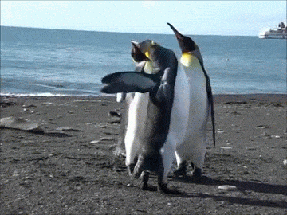
L – Liskov’s Substitutionl Principle
Solution problem:
Instead of having fly in Bird, further subdivide the Bird interface into flight and non flight birds.
With a quick restructure, both Owl and Penguin can peck, however only the Owls can fly!
Bird
- peck()
FlightyBird
- fly()
NonFlightyBird
- flap()
Owl
Penguin

Slide 23
I – Interface Segregation Principle
The interface segregation principle states you shouldn’t be forced to depend on methods that will not use.
In other words, only have methods in an interface together if they all need to be implemented.

Slide 24
I – Interface Segregation Principle
Example Problem: We want to use interfaces as a template for converting excel formats
We have a SpreadSheetConversion interface.
This interface will have methods for ExcelToCSV(), CSVToExcel(), CSVtoPDF(), ExcelToPDF()
When we create a Converter class which implements this interface we are going to have to override all of these methods. However I might only need the Excel-CSV functions, not all of them!
Notes:
The remaining methods would end up being overridden with methods which would simply throw “unsupported” exceptions.

Slide 25
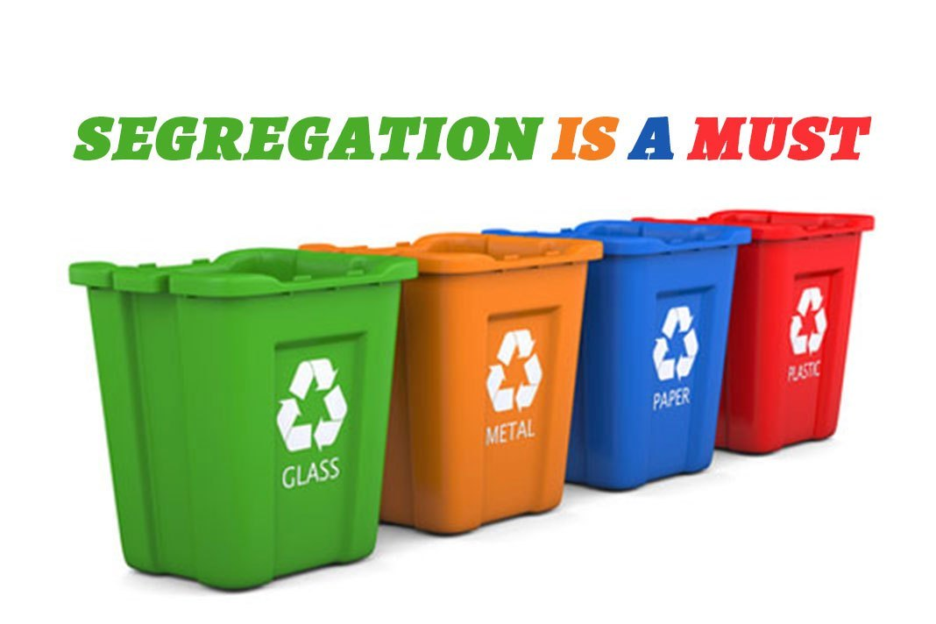
I – Interface Segregation Principle
Solution:
Have an ExcelCSVCoverter interface and SpreadsheetToPDF interface.
ExcelCSVConverter would contain: ExcelToCSV() and CSVToExcel()
SpreadSheetToPDF would contain: ExcelToPDF() and CSVToPDF()
If you were going to need to convert from an Excel file to a CSV file and vice versa, you would use the ExcelCSVConverter interface. Meaning you do not need to override PDF methods that you are not going to use.
If you only need one of these methods inside the interface. It would be good practice to segregate it further!

Slide 26
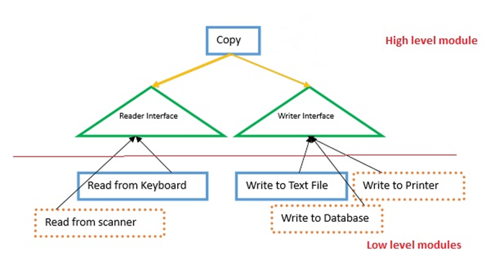
D – Dependency Inversion Principle
The dependency inversion principle has two key points.
1) High-level modules should not depend on low-level modules. Both should depend on abstractions.
From point number 1, it simply means, that our classes should be based on interfaces, regardless of whether they are high level modules or the low-level modules that they call.
This leads to maintainable, testable, flexible code.

Slide 27
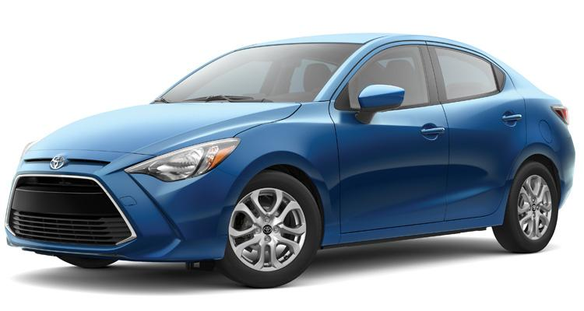
D – Dependency Inversion Principle
2) Abstractions should not depend on details. Details should depend on abstractions.
Simply put, if the details change, the abstraction shouldn’t. Abstractions are the way clients view an object.
Lets take a car. Pedals, gearboxes and steering wheel are abstractions for what goes on inside the vehicle. If we change the engine details, I am still going to interact with the car in the exact same manner.
If you follow the open/close principle and interface segregation principle the dependency inversion principle is also likely to be followed.

Slide 28
Course Objectives - Summary
Describe each of the components of the SOLID design principle.
Single Responsibility Principle – Each class should have a single responsibility.
Open/Closed Principle – Classes should be open for extension, but closed to modification.
Liskov’s Substitution Principle – Pointers to base classes must be able to use objects of derived classes without knowing it.
Interface Segregation Principle – You shouldn’t be forced to depend on methods that will not use.
Dependency Inversion Principle – Classes and details should depend on abstractions.
Discuss why the SOLID principles should be adopted in OOP
They create maintainable, flexible, testable code.

Slide 29
Thank you for listening.
ANY QUESTIONS?

